Slide 1

Topic: The Process Abstraction
Lecture: Dr. Zhao Jie
Date: 01/21/20246

Slide 2
Agenda
The virtualization of the CPU
Scheduling policy
States of a process

Slide 3
Reading Assignment
Chapters 4

Slide 4
How many processes and CPUs?
Process
A running program
Described states: address space, program counter(PC), and stack pointer(SP)
The virtualization of the CPU
Many processes VS one physical CPU
Physically: one program running, and the rest waiting until the one is finished
Virtualized: many processes running, and each of them occupying one CPU

Slide 5
Implementing the virtualization of the CPU
Mechanism
Time-sharing between processes
Scheduling policy
Give a number of possible programs to run on a CPU, which program should the OS run?

Slide 6
A process combinations
Instruction
Fetch from memory
Data
Also, fetch from memory
Stack
Allocated the memory space when the process is created.
Saved as local variables, function parameters, and return addresses
Heap
Explicitly requested dynamically-allocated data

Slide 7
States of a process
Three states
Running, Ready, and Block
Running
Currently executing process
Ready
The process is ready, but waiting for the CPU resource
Block
The process is not ready, but extra assistance is necessary to make it ready.

Slide 8
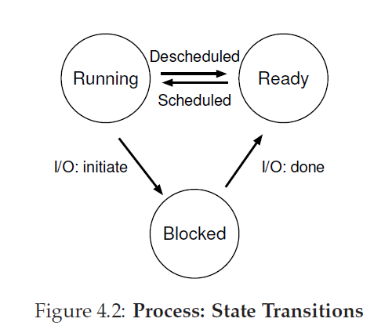
Process state transitions
Scheduled: Ready to Running
Descheduled: Running to Ready

Slide 9
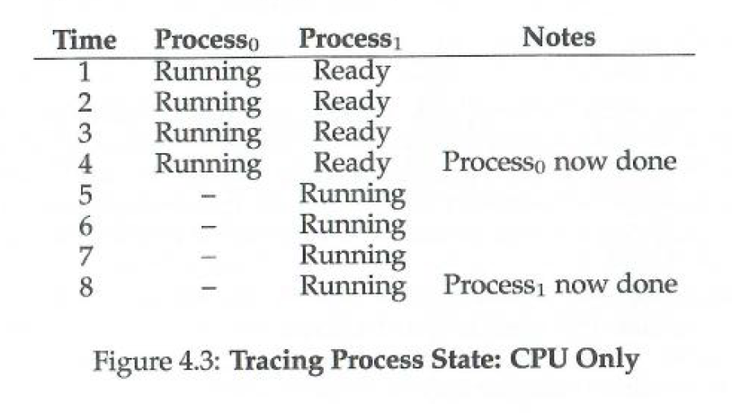
Trace table with CPU only
How long does Process0 take to complete the execution? How long does Process1 take to complete the execution? (Assume each time stamp takes one second.)

Slide 10
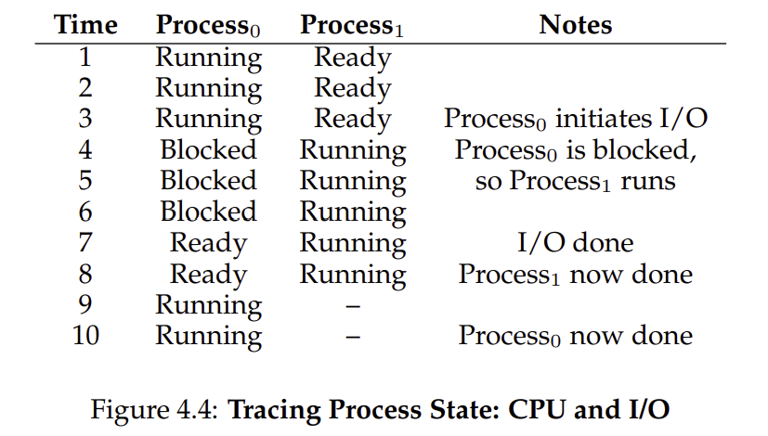
Trace table with CPU and I/O
How long does Process0 take to complete the execution? How long does Process1 take to complete the execution? (Assume each time stamp takes one second.)

Slide 11
Example discussions
Being blocked is caused by I/O for most of the time. When reading/writing from/into a disk, the speed to disk is much slower than the speed to read/write from/into a CPU register. Thus, the CPU waiting for I/O access wastes time.
For efficiency, When Process0 is block for I/O access, Process1 can occupy the CPU resource if it is ready.

